Slide 1
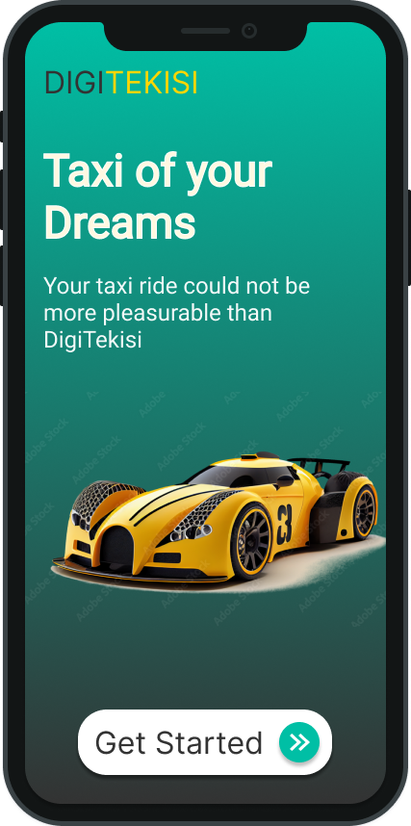
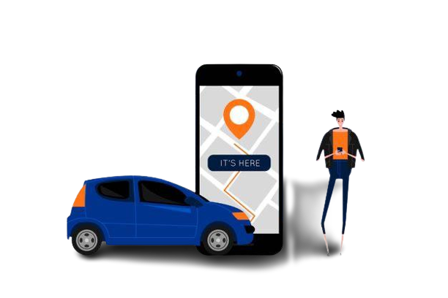
DIGITEKISI
FIGMA DESIGN AND REACT NATIVE IMPLEMENTATION
Notes:
INTRODUCTION

Slide 2
DESIGN PHASE
SYSTEM OVERVIEW
DIGITEKISI
UI DESIGN AND IMPLEMENTATION
You Tekisi with Us, You Win
SUMMARY AND CONCLUSION
Notes:
TABLE OF CONTENTS

Slide 3
SYSTEM OVERVIEW
The system provides real-time updates of the passenger and driver locations on a map, allowing both parties to track each other's movements.
Real-time Location Tracking
Passengers can view the estimated arrival time of their drivers, helping them plan their schedules more effectively.
Estimated Time of Arrival (ETA)
The system enables passengers and drivers to have a clear view of each other's locations, enhancing safety during pickups and drop-offs.
Improved Safety
Notes:
OVERVIEW

Slide 4
FIGMA DESIGN
DESIGN CREATION AND ITERATION
COLLABORATIVE DESIGN
HANDOFF TO DEVELOPERS
Figma played a crucial role in designing the DIGITEKISI User Interface like:
Figma provides a powerful platform for creating and iterating on the design of the interface. It offers a wide range of design tools, including vector editing, layout controls, and typography options.
Figma facilitates the handoff of design assets to developers. Designers can generate design specifications, export assets, and share design guidelines directly from Figma.
Figma is a web-based design tool that enables real-time collaboration among team members. Designers can work together, share their designs, and provide feedback on the interface.
Notes:
FIGMA OVERVIEW

Slide 5
DESIGN PHILOSOPHY
Our philosophy while designing this platform was centered around two things:
The User Experience
Quick Iteration between design and development
Notes:
PASSENGER REGISTRATION SCREEN

Slide 6
AUTHENTICATION FLOW
SIGNUP
Involves filling in credentials and validating Email
Authentication Flow
LOGIN
Involves passing correct
credentials
RESET PASSWORD
Involves validating email and creating new passwords

Slide 7
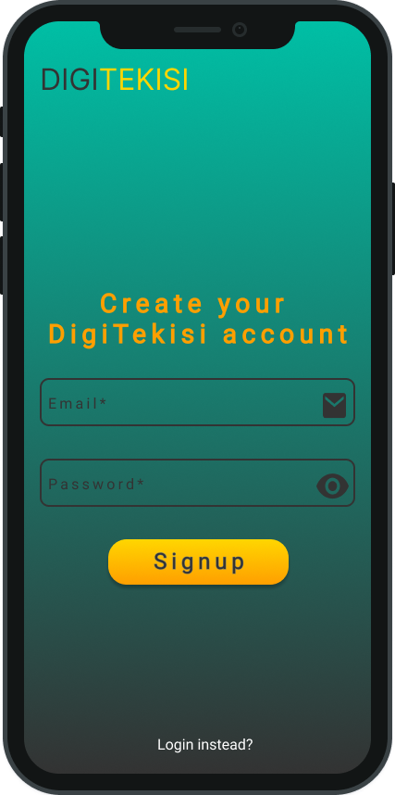
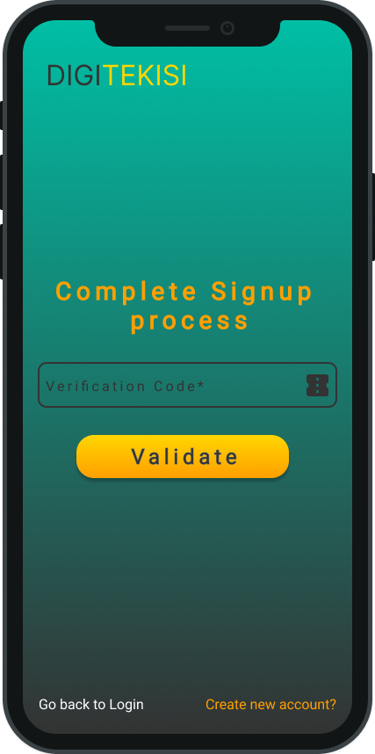
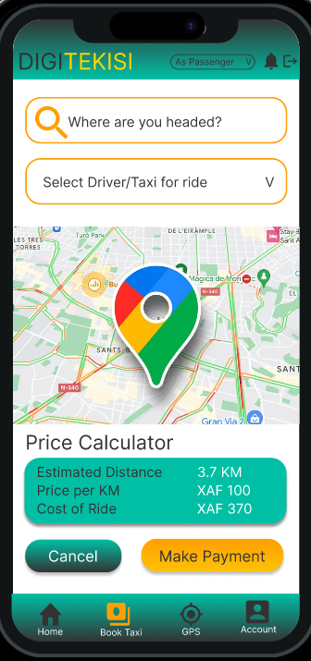
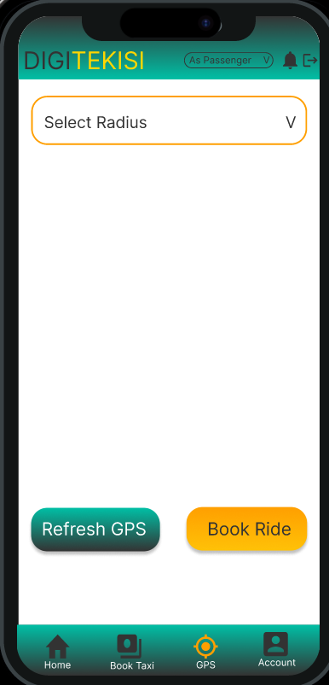
SIGNUP FLOW
Notes:
PASSENGER SCREEN

Slide 8
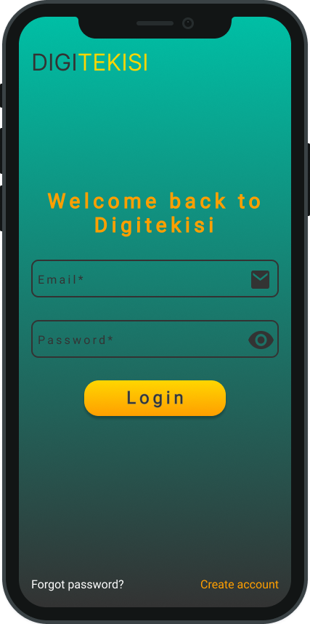
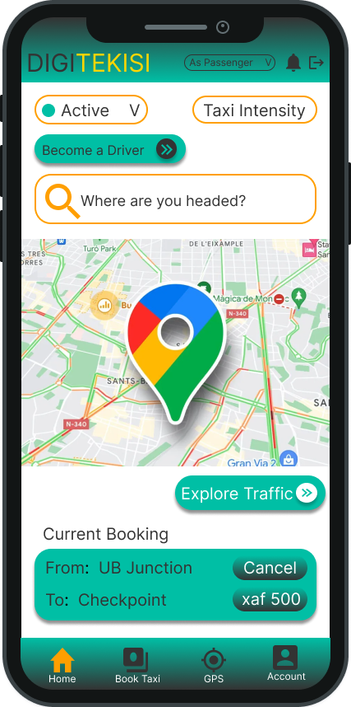
LOGIN FLOW
Notes:
PASSENGER SCREEN

Slide 9
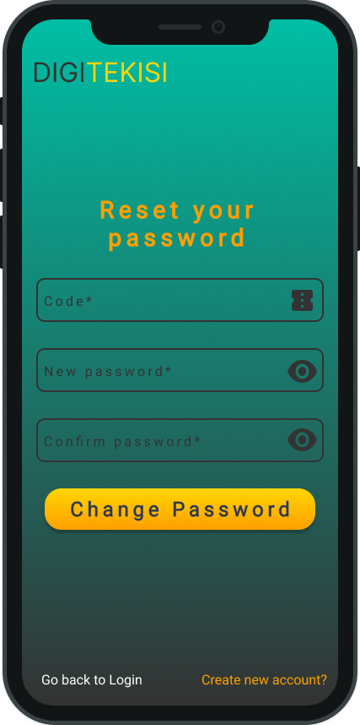
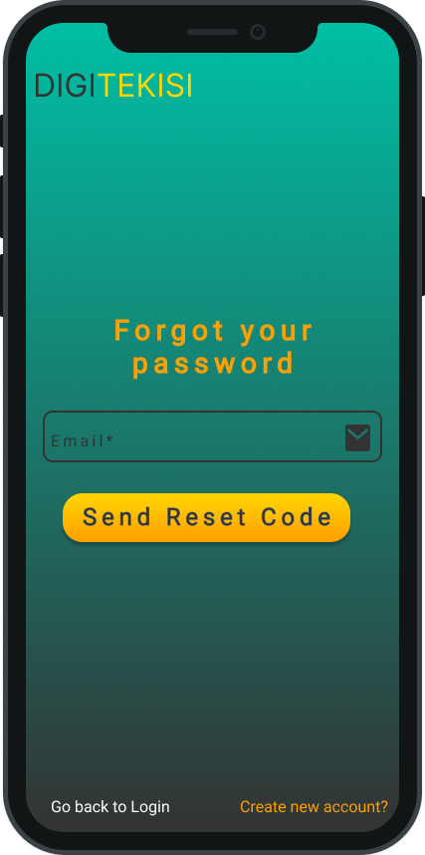
PASSWORD RESET
Notes:
PASSENGER SCREEN

Slide 10
Dashboard Navigation
Can only be done by passengers.
Book Rides
Navigating Homepage
Both passengers and drivers can manage their accounts albeit, with different functionalities
Manage Account
Passengers can view taxi intensity while drivers can view passengers intensity
Traffic Overview

Slide 11
Overview of Passenger Homepage
View Notifications, switch between modes(Driver, Passenger, Set Status
Can view traffic intensity
Initiate Ride booking process
Can view Current Tekisi Booking
Notes:
PASSENGER SCREEN

Slide 12
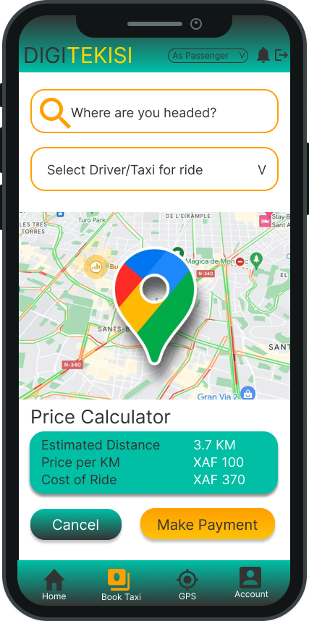
How To Book a Tekisi
Set Destination
Select Driver based on the active status
Initiate Payment for Ride
Cancel Ride
Notes:
PASSENGER SCREEN

Slide 13
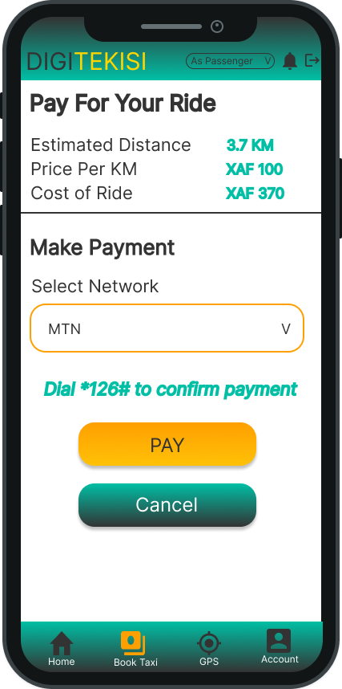
How To Pay for Ride
Select Means of Payment
Make Payment for Ride
Cancel Payment
Notes:
PASSENGER SCREEN

Slide 14
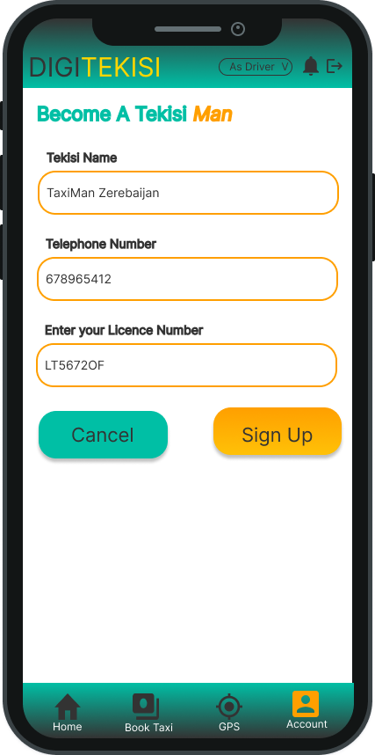
How to Register As Tekisi Man
The process is as simple as passing your Tekisi name, telephone Number and LIcence Number
Notes:
PASSENGER SCREEN

Slide 15
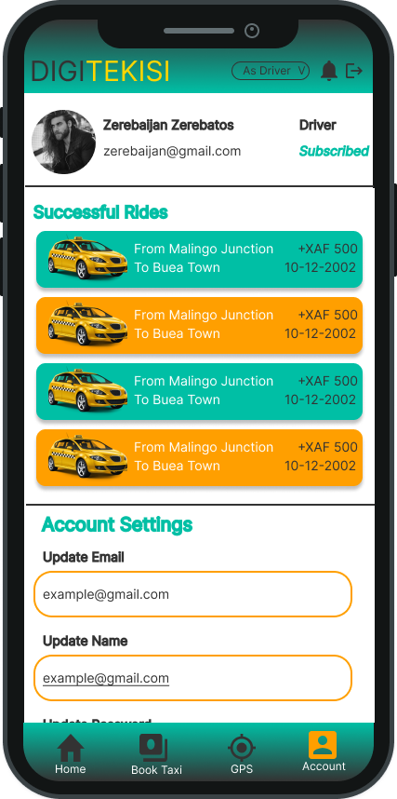
Account Profile
Both Passengers and Drivers can Manage their accounts from a similar portal, albeit with different functionalities
Notes:
PASSENGER SCREEN

Slide 16
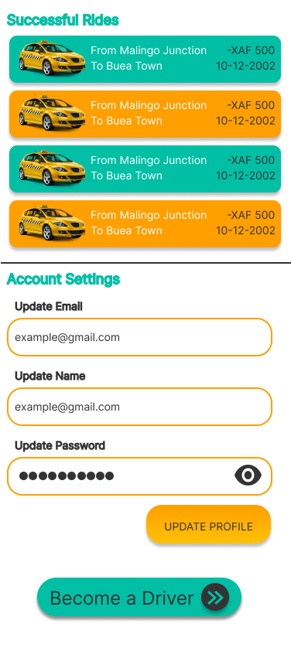
What can passengers do
In Their Profiles?
Notes:
PASSENGER SCREEN

Slide 17
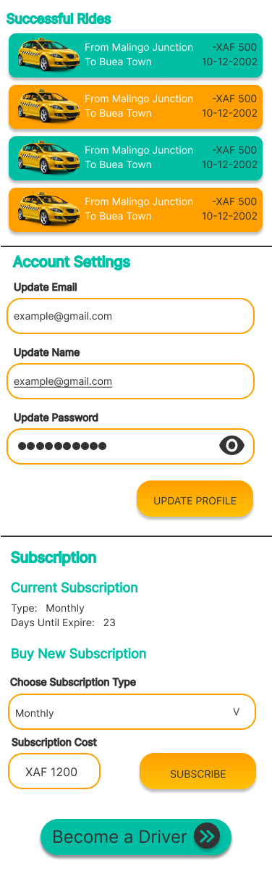
What can Drivers do
In Their Profiles?
Notes:
PASSENGER SCREEN

Slide 18
SUMMARY & CONCLUSION
The passenger and driver positioning system offers benefits such as safety, efficient routing, communication, transparency, and improved user experience. Figma streamlines the design process and facilitates collaboration, while React Native implementation ensures reliability and user-friendliness. Together, Figma design capabilities and React Native's implementation create a robust system for passenger and driver positioning.
In a nutshell, the design and implementation of a passenger and driver positioning system is more than just drawing shapes and coding UIs. It aims to improve transportation services by enhancing user experience and efficiency. Figma enables collaborative design, prototyping, and design component management.
Notes:
PASSENGER SCREEN

Slide 19
THANK YOU !!!
Notes:
PASSENGER SCREEN

